Slide 1
The Evolution of CAPTA: Supporting Families Impacted by Substance Use
Mary Fitzgerald, LMSW
SEPI-CT Family Care Plan Coordinator
Wheeler Clinic/CT clearinghouse

Slide 2
This presentation has been created by the Department of Mental Health and Addiction Services and modified to update content.

Slide 3
About the Initiative
SEPI-CT (formally SEI-FASD Statewide Initiative) aims to strengthen capacity at the community, provider, and systems levels to improve the health and well-being of infants born substance exposed through supporting the recovery of pregnant people and their families.
SEPI-CT rebranded from SEI-FASD to be more inclusive of all involved in and affected by the work.
This initiative is funded by CT DMHAS and CT DCF and contracted through Wheeler.

Slide 4
Today’s objectives are to:
Understand how to develop a Family Care Plan collaboratively with patients
4
Understand the role of stigma in creating barriers to accessing healthcare
3
Discuss the difference between a DCF report and a DCF notification
2
Discuss CAPTA and CARA legislation and how it impacts birthing persons and families
1
Identify resources that are critical to developing a comprehensive Family Care Plan
5

Slide 5
What we know:
The opioid epidemic is impacting all 50 states.
Substance use disorders impact all races, ages, genders, and economic classes.
The problem is getting bigger and as a result more lives have been lost.
Addiction is a disease like any other medical condition, but it is often viewed very differently …
Notes:
To help frame today’s discussion, I want to spend a minute talking about the Opioid epidemic. We know that the Opioid Issue is a National Epidemic AND that there are also more commonly used substances (like alcohol and marijuana) that also negative impact people’s lives.
The Opioid Epidemic, though, because of the lethality of the substance has been driving an increase in the deaths associated with substance use disorders, and has truly become a public health crisis.
We also know that Substance Use Disorders are a medical condition that do not discriminate and are an issue in ALL communities. Yet there continues to be a lot of stigma surrounding substance use disorders that we don’t see with other medical conditions, such as cancer or diabetes.

Slide 6
Notes:
People are coming in at various stages of change and there are services to support them at each level and people should be checking in to see which stage of change they’re at and which services they need.So for those of you that may not be aware, the Stage of Change model is something that we use a lot in behavioral health. This model provides a helpful framework to assess an individual’s readiness to change a behavior and will help the provider to determine the best interventions and resources based on where a person is in this process. So part of what we are assessing when we meet with individuals to develop plans of safe care is a person’s readiness to engage in treatment or other services, and it is crucial to meet people where they are at in this process. We use the term – meet people where they are at a lot in behavioral health, and this really speaks to empowering individuals to be the decision makers in their own journeys. For example, if you have an individual that is struggling to stop their substance use and you feel as their provider that they really would benefit from a residential treatment program, you can discuss that with them in an empathetic way and talk about the potential benefits. However, if they are not ready to make that step, perhaps you provide them with resources for a peer recovery coach or 12 step meetings in the area or give them a brochure or other resources that they can visit after leaving your office.

Slide 7
CAPTA NOTIFICATION Child Abuse Prevention and Treatment Act
Provisions for Infants born substance exposed
Notes:
Will explain CAPTA notification process, which went into effect 3/15/19.

Slide 8
CAPTA
Child Abuse Prevention and Treatment Act (CAPTA) was enacted in 1974
Provides federal funding to support prevention, assessment, investigation, prosecution, and treatment activities related to child abuse and neglect
Provides for minimum definition of child abuse and neglect, child abuse and neglect response and overall confidentiality of these cases

Slide 9
Keeping Families and Children Safe Act
Amended CAPTA in 2003
To receive CAPTA funds, states must have policies and procedures to address the needs of “substance-exposed infants born and identified as being affected by ILLEGAL substance use or withdrawal symptoms resulting from prenatal drug exposure.”
Make appropriate referrals to services to address the needs of infant
Develop a Plan of Safe Care for affected infants
CAPTA Reauthorization Act passed in 2010

Slide 10
CARA
In 2016, Congress passed the Comprehensive Addiction and Recovery Act (CARA) which established a comprehensive strategy through enhanced grant programs that expanded prevention and education efforts while also promoting treatment and recovery
CARA clarified population requiring a “Plan of Safe Care”: any infant born with and affected by substance use, withdrawal symptoms or Fetal Alcohol Spectrum Disorder
Required Plan of Safe Care to include the needs of both the infant and family/caregiver
Pending 2023 legislation changes language from Plan of Safe Care to Family Care Plan
DCF considered Federal requirements of both CAPTA and CARA in its deliberation and development of CT legislation

Slide 11
State Impact
States are required to develop policies and procedures for the notification to child protective services of the birth of an infant affected by prenatal drug or alcohol exposure
Ensure stakeholders support the development of Family Care Plans for families who have prenatal substance use exposure
Develop a process for screening and early intervention

Slide 12
CT State Legislation
CT Public Act 18-111,Sec 5, amending C.G.S 171-102a https://www.cga.ct.gov/2018/ACT/pa/pdf/2018PA-00111-R00HB-05332-PA.pdf
The creation of written Family Care Plans, which must be developed between the mothers of their newborns and their providers.
A provider involved in the delivery or care of a newborn who, in the provider’s estimation, exhibits physical, neurological, or behavioral symptoms consistent with prenatal substance exposure, associated withdrawal symptoms, or fetal alcohol spectrum disorder must notify DCF of these conditions in the newborn.

Slide 13
Where We are Today
Currently have a 5-year strategic plan (2022-2027)
Funding by DMHAS & DCF of SEPI-CT Program Manager and Family Care Plan Coordinator based in Wheeler Clinic
Established 4 priority areas: CAPTA/FCP, Marketing and Training, Screening and Brief Intervention, Treatment Recovery and Wellness
Second phase launched in 2022 of Substance Exposed Pregnancy Initiative of CT (SEPI-CT)
Participation in 2023 Policy Academy to further work being done

Slide 14
CAPTA SEI Definition
Infants born affected by substance use, withdrawal symptoms resulting from prenatal drug exposure, or a Fetal Alcohol Spectrum Disorder
Healthcare providers involved in the delivery of an infant born substance exposed must submit a DCF CAPTA Notification. A Family Care Plan is to be developed for these infants and their families.
The requirements are intended to provide the needed services and supports for infants with prenatal exposure, the birthing person with substance use disorders and their families to ensure a comprehensive response to the effects of prenatal exposure.
Congress stated that these reports to DCF, on their own, are not grounds to substantiate child abuse or neglect.
Notes:
There are 3 things to remember about CAPTA
Healthcare providers involved in the delivery of an infant must NOTIFY child protective services that an infant was born substance exposed.
Child protective services need to ensure that a Plan of Safe Care is developed for these infants and their families. (will explain more of what a POSC is in a bit)
The notification is NOT the same as a report.

Slide 15
A Collaboration Between:
Persons with lived experience,
Moms/Birthing Persons
Partners/Families,
Health care providers,
Social Workers,
& Key Providers:
Notes:
Before I review CT’s notification process, I want to explain how we got there:
federal guidance
developed a CAPTA STAKEHOLDER Group (partnership of key stakeholders who work with infants, caregivers, and families impacted by substance use. Includes:
persons with lived experience, various state agencies, CT hospital association, Hospital social workers, pediatricians and obgyns.
Held several focus groups at the pregnant and parenting women’s residential programs. Explained the legislation and asked for input on how to put it in place
Highlight collaboration between persons with lived experience

Slide 16
CT Definition of Infant Born Substance Exposed for Notification Purposes:
Newborn exposed in utero to:
Newborn with withdrawal symptoms
Diagnosed with Fetal Alcohol Syndrome
Methadone
Buprenorphine
Prescription opioids
Cannabis
Cocaine
PCP
Alcohol
Prescription benzodiazepines
Other illegal/non-prescribed medication, and/or the misuse of prescription/over the counter medication
Notes:
Connecticut defined infants born substance exposed to include three sets of conditions.
1) exposure during pregnancy to any of these substances or conditions: methadone, buprenorphine, prescription opioids, marijuana, cocaine, PCP, prescription benzodiazepines, alcohol, other illegal/non-prescribed medication, and/or the misuse of prescription/over the counter medication.
2) This includes infant born substance exposed includes a newborn with withdrawal symptoms.
3) diagnosed with Fetal Alcohol Syndrome. (recognizing this would be rare, but it is in the federal legislation.

Slide 17
Cannabis Use
Any in utero exposure to cannabis constitutes meeting the requirement to submit a NOTIFICATION through the CAPTA Portal.
Cannabis is no longer illegal for adults 21& above in Connecticut, however, it remains illegal on the federal level. As CAPTA is a federal initiative, and includes both legal & illegal substances, it remains included in the list.
Whether or not the concerns of substance exposure meet the threshold for investigation of abuse and neglect concerns by DCF will be determined by the questions answered in the CAPTA Portal.

Slide 18
DCF Newborn Notification Portal
Effective 3.15.19, at the time of a birth event, hospitals are required to submit a notification when:
An infant is born substance exposed
A newborn experiences withdrawal symptom
An infant is diagnosed with Fetal Alcohol Syndrome
If there are suspicions of abuse and neglect at the time of the birthing event, hospitals will use the online portal to submit a DCF report
Notes:
On March 15th 2019, we launched an online portal for all birthing hospitals.
All infants who need a CAPTA notification or a Careline submission do so through an online portal.

Slide 19
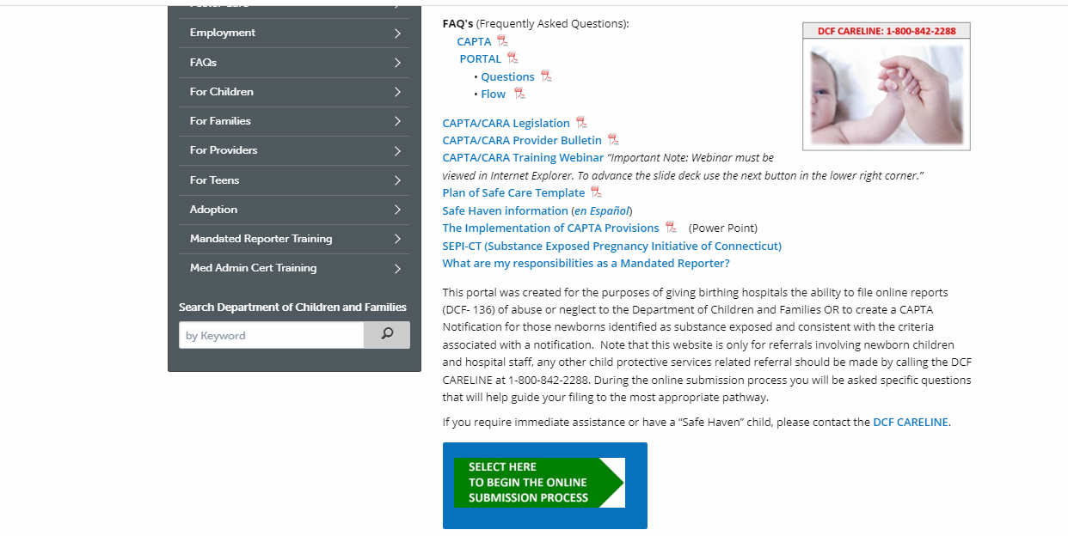
Making a CAPTA Notification Report
https://portal.ct.gov/DCF/CAPTA/HOME

Slide 20
What is the difference between a DCF report and a DCF CAPTA notification?

Slide 21
DCF CAPTA Notification
Occurs when an infant has been born after being exposed to certain substances (because birthing person used substances during pregnancy)
There are no other concerns about safety, a Family Care Plan has been developed and/or verified, and infant has not tested positive due to maternal misuse
No identifying information on family, birthing person, and infant
Submitted exclusively through the DCF CAPTA Notification Portal

Slide 22
DCF Report
Occurs when anyone has concerns about the safety of a child
Concerns are reported through the online portal for birthing hospitals
DCF reviews the information submitted by the provider to determine if further assessment is needed

Slide 23
Submitting a CAPTA Notification
Hospitals are the only entities that can submit one
Information entered is de-identified
Race of infant & birthing person
Zip code of residency
Type of substance exposure
Outcome of testing in the hospital
Family Care Plan is verified and there are no other concerns of abuse or neglect
Data is housed through DCF’s data system and shared with the federal government to assess resources, policy, and practice changes
Notes:
data also is shared with other state partners, community providers and those with lived experience to help the state make policy, education, training and service decisions.

Slide 24
Making a DCF Report
CAPTA Notification Portal will direct hospital staff to the DCF Report page if:
No Family Care Plan is developed or verified
There are concerns that substance use will impact parental functioning
Infant tests positive for substances due to maternal misuse*
Infant does not test positive for substances, but staff has concerns about abuse or neglect
*current language in portal states maternal misuse, however DCF and DMHAS are working in collaboration to change this language to maternal substance use to lessen stigma and remove it as a criteria that would lead to a DCF report

Slide 25
A Look at DCF Data…

Slide 26
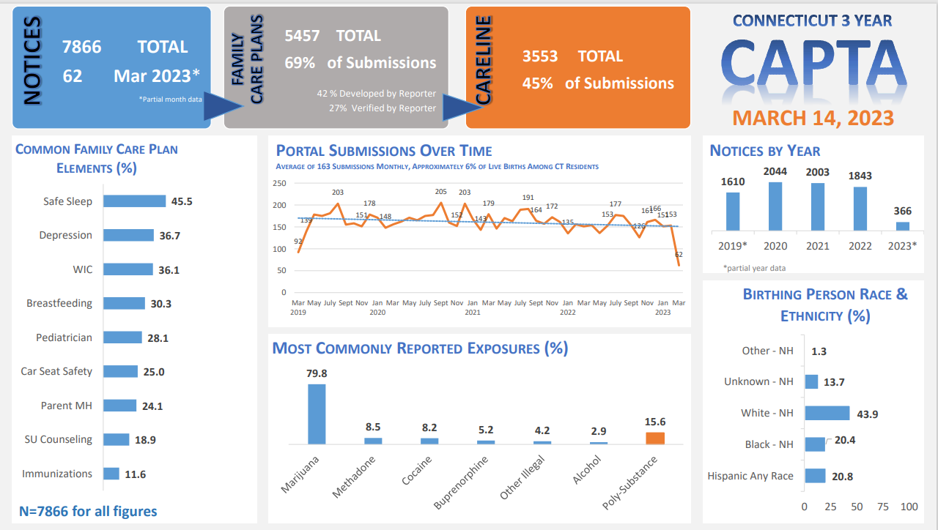
CT’s CAPTA system of notification is designed to triage hospital reports to DCF

Slide 27
Empathy
Brené Brown on Empathy vs Sympathy - YouTube
Notes:
We are going to now take a few minutes to watch a video on empathy from Brene Brown, and as you are watching I want you to try to think about why I’ve included this video into the discussion on CAPTA and Plans of Safe Care…

Slide 28
“Empathy Fuels Connection”
The 4 Qualities of Empathy:
1. Perspective Taking
2. Staying out of Judgement
3. Recognizing Emotions in others
4. Communicating those emotions
“In order to connect with others, we must connect with ourselves.” *Source: Brene Brown
Notes:
So I hope you were all able to get something out of that video. I know, for me Brene always has a great way of putting things into such a relatable context.
We know that folks needing a Plan of Safe Care have been highly stigmatized and in many cases have experienced trauma as a result of the judgmental attitudes and beliefs they have encountered when trying to seek help. So the way we engage in these conversations is so important. If we use an empathetic lens we are able to connect more effectively and increase the likelihood that someone will feel safe to accept help or seek help again in the future.
We know that the folks that work in hospitals and have firsthand knowledge of the impact of substance use in regards to the baby and this can bring up difficult feelings. However, we need to balance that with the understanding that addiction is disease and that individuals with substance use disorders need to be supported and valued as parents, and connected to resources to help support their recovery and baby.

Slide 29
Understanding Stigma and SUD
Stigma means labeling, stereotyping and discrimination a person or group of people because they have done something society does not approve of
Stigma is persistent, pervasive, and rooted in the belief that addiction is a personal choice reflecting a lack of willpower and a moral failing.
Damages the health and well-being of people with substance use disorder
Interferes with the quality of care people receive in clinical settings
Notes:
https://www.cthealth.org/wp-content/uploads/2020/01/Health-disparities-in-Connecticut.pdf

Slide 30
Consequences of Stigma
Mental Health/Trauma – chronic exposure to prejudice, rejection, judgement, and discrimination
Low self-esteem, feelings of hopelessness, fear, depression, anxiety, increased substance use
Internalizing stigma -- Feelings of shame and guilt which decrease the likelihood of seeking treatment or having access to harm reduction strategies and resources
Decreased chance of seeking treatment can lead to increased economic, social, and medical costs
Distrust of community/medical/police/criminal justice providers
Health disparities
Legal and/or Child protective involvement

Slide 31
Maternal Health Disparities in CT Statistics taken from Health Disparities in Connecticut 2020
Infants born to black mothers are 4x more likely to die before 1st birthday than infants born to white mothers
Infants born to black women are twice as likely to have low birthweight than those born to white women
CT has second-lowest mortality rate for babies born to white mothers (2.9 per 1000 births)
CT has higher than national average mortality rate for babies born to black mothers (11.7 per 1000 births)
Root causes stem from higher uninsured rate, lack of access to regular healthcare provider, physical toll from discrimination, disparate health treatment
Notes:
https://www.cthealth.org/wp-content/uploads/2020/01/Health-disparities-in-Connecticut.pdf
Many studies have shown that black and Latino patients receive less aggressive treatment than white patients. Research has found that, for example, Hispanic patients were half as likely to be given pain medication when they went to the emergency room with a broken bone
Studies have found links between experiencing discrimination and negative physical and mental health consequences including depression, anxiety, hypertension, breast cancer, and giving birth preterm or having a low-birthweight baby. Research suggests that one way discrimination could lead to poorer health is through repeated activation of the body’s stress response system, which can have negative long-term physiological and psychological effects.

Slide 32
Considerations for the LGBTQ+ Community
Biological or assigned sex does not always tell the complete story
Assigned female at birth -- trans male. non-binary, intersex
Trauma when accessing medical care
Avoiding assumptions about gender and family structure
Inclusive Language, Pronouns
Important to think about how your policies and practices can be as inclusive as possible
LGBTQ+ Resources For Professionals
LGBTQ+ Resources For Patients

Slide 33
Reducing Stigma
Universal Screening
Be Non-Judgmental
Use Person-First Language
Harm Reduction
Provide Inclusive Care
Notes:
If you are a provider, incorporating screening for substance use and substance use disorders into every encounter gives all patients the opportunity to receive support for their individual needs and challenges. Consider validated screening tools such as 4 Ps, 5 Ps, ASSIST, T-ACE, or AUDIT.
Use nonjudgmental, nonmoralistic, and nonthreatening language when asking individuals about substance use. It is important to recognize personal attitudes that may influence a person's response. Stress harm reduction and meet them where they are at.
If an individual is not ready to stop using substances, talk to them about their willingness to engage in harm reduction practices. You can also provide education on overdose prevention. Offer resources that can help someone use substances more safely.

Slide 34
Phrases to Use and Not Use
Say This
Not That
Substance Use Disorder
Addiction
Person with a Substance Use Disorder
Substance-Exposed Infant
In Recovery
Negative or Positive Toxicology Results
Substance Abuse/Drug Abuse
Drug Habit
Addict/Junkie/Drug Abuser
Addicted Baby
Clean
Clean or Dirty Toxicology Results

Slide 35
Mitigating Possible Unintended Consequences
Avoiding unnecessary DCF Reports
Puts undue stress on a new parent who is well connected to services
Additional strain on DCF system
Empowering birthing people to make their own healthcare choices and take the lead on their plan
Increase access to prenatal care and delivering in a birthing hospital
Sharing the plan well in advance with medical providers & allowing time for collaboration
Time of delivery is not the ideal time to be introducing the Family Care Plan to the woman/birthing person or the hospital
Stigma & Cultural Implications
Racial, socioeconomic, and LGBTQ+ healthcare disparities
Notes:
It is essential that DCF are partners at the table. We want the right cases that need to go to DCF and not backlog an already overburdened system or retraumatize folks from involvement in the systems when it’s not warranted.

Slide 36
Supporting Patients in Family Care Plan Development

Slide 37
What is a Family Care Plan?
Document that provides a roadmap of supports for birthing person, baby and family
Includes strategies and services that support the health and wellbeing of newborns and the substance use treatment and recovery of the birthing person
Must be verified or developed at time of birth
Meets needs of birthing person, infant, and family

Slide 38
Educating & Empowering Birthing Persons
It is important that all pregnant birthing persons are educated on the CAPTA legislation early in their pregnancy and talk through decisions they can make before delivery
This provides an opportunity for providers to give correct information;
To dispel myths and talk through fears;
To allow for behavioral change around use;
To help explore their support system and begin to think about what they will need to be successful
AND…
Notes:
Engagement is process. Best to engage individuals in conversations early in pregnancy and to keep revisiting them. Provide education and give individual time to ask questions, think things through, process their reactions, etc.
Plan development and support – work with individual as early in pregnancy and throughout pregnancy to develop the plan and identify areas that are needed for support. This may look very different at the one month mark vs. 8 month mark of pregnancy. Plan is an evolving tool that can be used to empower mom and can highlight strengths and progress
Interagency collaboration – collaboration is key. If you are the provider that has taken the lead with mom on the Plan, work with mom to sign ROI for other providers, particularly their medical team, to ensure all providers are aware of the plan in advance. Never assume just because mom is engaged with other providers that they have discussed CAPTA
In community vs. hospital
For those in the hospital setting, you have a general sense of how long the person will be there. You may want to go in and discuss Plans of Safe Care a few hours post-delivery to plant the seed. Then you may go back and give more information later, and then go back again to actually develop the Plan. Waiting until right before discharge is not the time to be starting the conversation about the plan.

Slide 39
Developing a Family Care Plan
Birthing Person is at the forefront:
They create the plan.
They choose which providers to include in the plan development & where they need support.
They have the ability to change the plan.
They present the plan to their medical team prior to or at time of delivery.
They live their plan.
Notes:
A very unique opportunity when mom/birthing persons are at a vulnerable place to help empower them and validate their experience and help them to feel strong and capable vs. feeling shame, and disempowered. How you frame the POSC, how you talk about it, can be a make or break moment for people. Even if there are areas that need to be worked on, working with them to identify strengths is vital. Even if they comes in with a POSC, the hospital staff need to be equipped to talk about the plan and review the plan in a way that feels empowering, supportive and strengths based

Slide 40
A team effort…
In addition to birthing person, many others may have input into the Family Care Plan
Partners and/or other family members
Health Care Providers
Recovery Supports
DCF Social Worker
Will only be involved if an open case for another child exists, can not open new case until infant is born
Notes:
Don’t assume someone else has done the plan. If you have a pregnant person with a substance use disorder, all providers involved should ideally be talking to mom/birthing person about CAPTA and communicating regarding who will be the lead provider

Slide 41
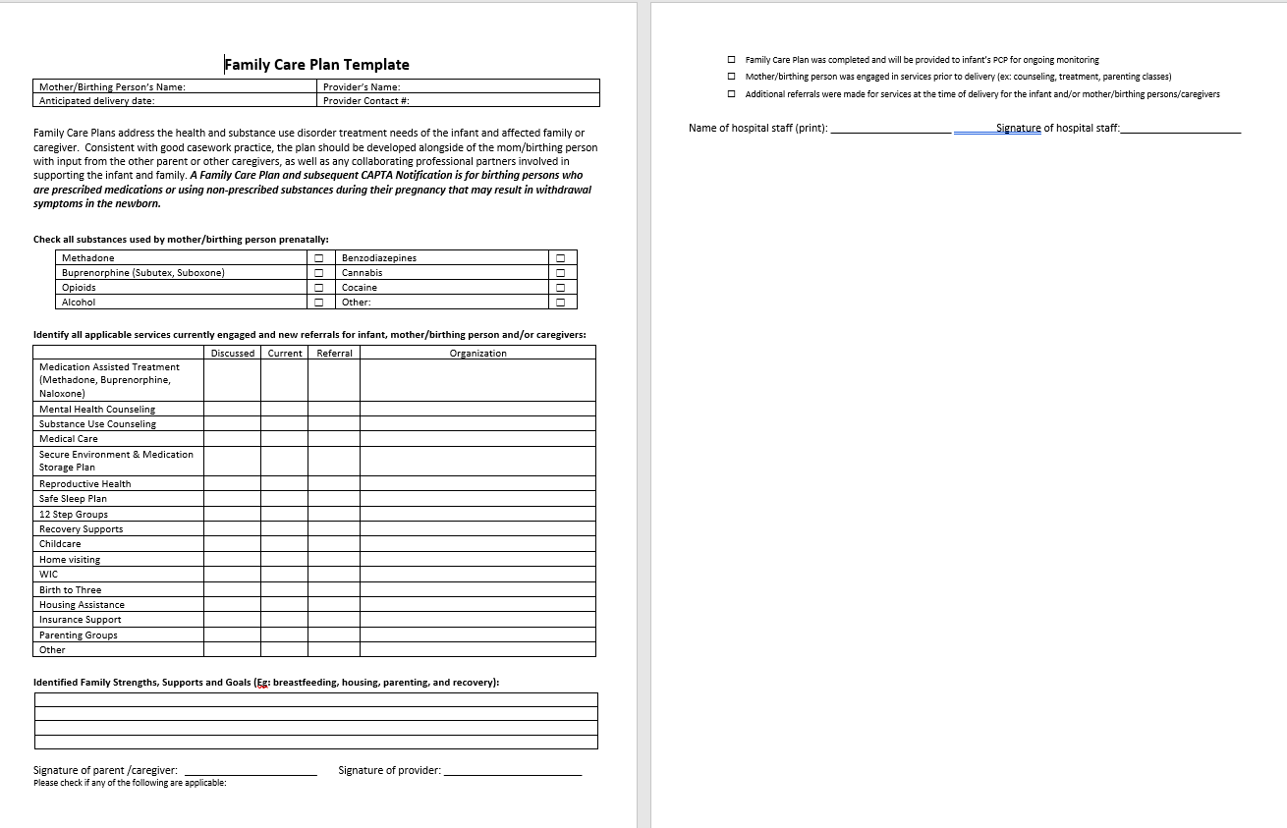
Find a Copy of the Template Here

Slide 42
Elements of the Plan
Medications including MAT
CT MAT Provider Map and Other Provider Resources
Overdose Prevention
Accessing Narcan in CT
Behavioral Health Services (Mental Health & Substance Use)
Department of Mental Health and Addiction Services
Recovery Supports
CT Community for Addiction Recovery (CCAR)
National Alliance on Mental Illness (NAMI)
Find AA Meetings or Find NA Meetings
DMHAS Women's REACH
CT Residential Bed Availability
Finding Services for Medicaid Patients
PROUD - Parents Recovering from Opioids Use Disorder (ct.gov)
Notes:
We often hear that there aren’t adequate resources to support folks with substance use needs, and our data often shows that we have beds throughout our services continuum that can meet people throughout their recovery journey. Traditional and nontraditional paths to recovery and everybody’s path may look different based on their own life circumstances, beliefs, or stage of change. May be more be successful if there needs and desires are met and worked with (i.e. flexibility with childcare, employment, etc).

Slide 43
Elements of the Plan continued…
Birth to Three (automatic eligibility)
Birth to Three
Home Visiting
Office of Early Childhood Home Visiting Programs
Childcare
CT Care 4 Kids
Housing
211 CT Housing and Homeless Shelters
COACH: COVID-19 Assistance for Community Health (ctstronger.org)
Safe Sleep Plan
Guide to Safe Sleep for Infants
Housing and Homeless Services (ct.gov)

Slide 44
Elements of the Plan continued
Parenting Support
Many hospitals offer support groups for new moms
CT Network of Care Parenting Support Services
CT Family Support Network for Children with Special Needs
DCF Parenting Support Services (PSS)
Financial Assistance
Many town social service agencies may have resources to support families
CT Network of Care Financial Assistance
DSS Financial and Employment Services
Medical Care (mom and baby)
Husky Clients: Find A Provider
Medication Secure Storage
Drug Free CT Secure Storage and Disposal
Reproductive Health
Planned Parenthood of Southern New England
Health Insurance Coverage: Access Health CT
Secure Storage of Medications and Substances
Women’s Health CT

Slide 45
Coordination & Collaboration
No one agency or program can provide all the services and supports that a new mom/birthing person will need
Establish connections in the community
Hospitals: Identify point person(s) to receive plans coming from outside agencies
Agencies: Identify point person(s) to send plan to hospital/OBGYN
Ensure releases are on file to share and promote delivery of plan to hospital
Establish multiple ways patient can access plan
Making the plan an ever-evolving tool
Notes:
The expectation is not that the hospital is expected to manage all of the aspects of the Plan, but they should know how to refer folks to resources that can assist. Ideally, community providers that are working with mom more closely regarding some of these needs should take the lead on supporting the Plan

Slide 46
The best-case scenario…
Individual learns of their pregnancy
Connects with community provider
Explores their intention around the pregnancy
Receives education around CAPTA & Family Care Plans
Explores intention around their use
Develop plan to support, refer for MAT & other services
Identifies team who will support her Family Care Plan
Signs ROIs to support communication
Develops Family Care Plan
Modifies plan over time as situation or recovery needs may change or evolve
Shares Family Care Plan
With partner, family members, providers, support network, etc.
Ensures medical team is aware/ NAS consult
Copy of plan is included in record and available to hospital in advance
Notes:
Highlight exploring intention around pregnancy

Slide 47
When Birthing Person Does Not Arrive to the Hospital with a Family Care Plan…
Review, verify, and/or develop a plan together with the birthing person
Assess existing concerns: do they fall under mandated reporting requirements?
Facilitate warm handoff to services
Obtain Release of Information and forward Family Care Plan to pediatrician

Slide 48
Agency Next Steps…
Modify
Modify Family Care Plan for your agency
Practice
Practice developing Family Care Plans
Integrating into rounds, supervision, team meetings
Modify
Modify Electronic Health Record
Develop
Develop policy & procedure to ensure a plan is developed with all pregnant women and document in EHR- to be reviewed at site visit
Develop
Develop relationships with collaborative partners in your community & mechanism to share plans
Review
Review materials available on SEPI-CT website
Implement
Implement agency wide training

Slide 49
Vignette
Jill is a 35 year-old married woman who comes into the hospital and delivers a small but healthy appearing baby boy at 38 weeks into her pregnancy. Jill discusses with you that she is in recovery for an opioid use disorder and has been on methadone for 3 years. Jill reports that she has not been using any other substances during her pregnancy, but does smoke about 3-4 cigarettes daily. She states she knows she “should have” quit smoking too while pregnant but was stressed out being pregnant and taking care of her two other children to give up smoking, as she feels this helps her cope. The meconium test hospital staff perform after the baby was born showed only methadone in the baby’s system, supporting Jill’s report. Jill states that she has completed a plan of safe care with her counselor at the methadone clinic and provides you their phone number to call. Jill’s wife comes to the hospital with their two other children, all seem happy for the new baby and appear supportive of Jill.

Slide 51
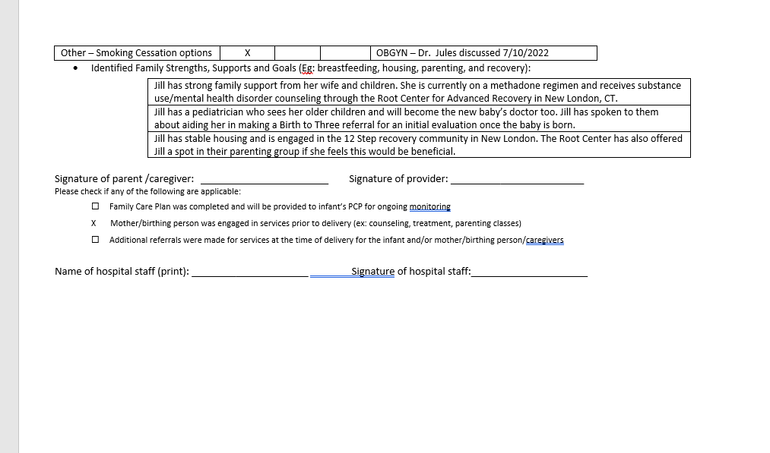

Slide 52
Resources & Treatment Options

Slide 53
Medication Assisted Recovery
The use of medications in combination with counseling and behavioral therapies to treat OUD and AUD and sustain recovery
Improves birth outcomes among people who have SUD and are pregnant
Relieves physiological cravings
Normalizes body functioning without negative effects of substance used
Medications include: Buprenorphine, Methadone, Suboxone and Naltrexone
Dose will likely need to be adjusted during pregnancy (increased) and postpartum (decreased) as MOUD/MAT may be metabolized differently during that time.
Research shows that the mortality rate of untreated individuals using heroin is 15 times higher compared to individuals receiving methadone maintenance treatment
Notes:
Being connected to MOUD/MAT offers individuals with the best chance for long-term sustained recovery and can give them the opportunity to help build their toolkit
*Source: Beacon Health Options White Paper on Opioid Crisis

Slide 54
Secure Storage Of Substances

Slide 55
Secure Storage Of Substances
SEPI CT Secure Storage of Medication and Other Substances Video
Keep cannabis, edibles, and substances stored out of sight and reach
Clean surfaces after use to reduce exposure risk: wipe tables, chairs, furniture, etc.
Keep prescriptions in original containers
Lock medications and substances using lock bags, boxes or safes
Order medication lock boxes for your nonprofit (Limited supplies)
Notes:
Clean surfaces after use and before feeding infants

Slide 56
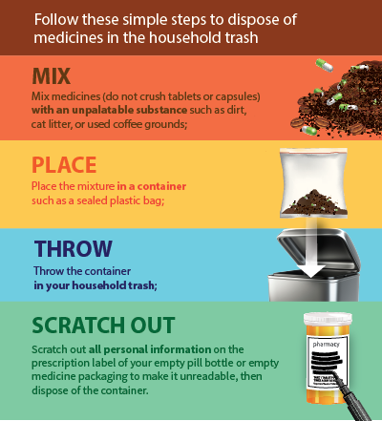
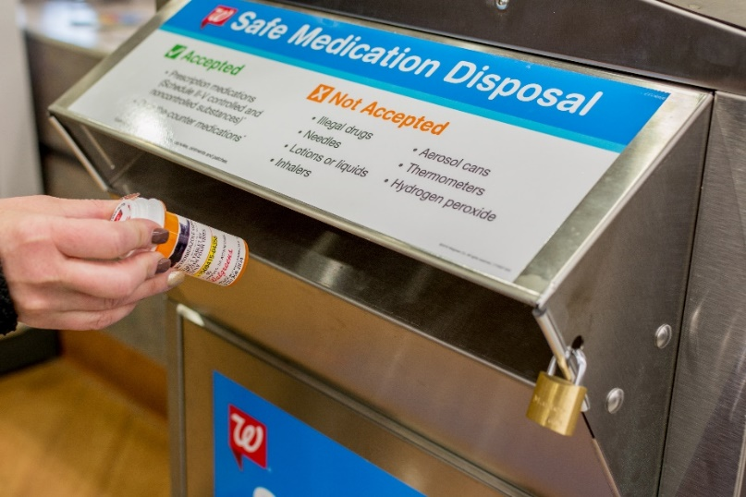
Options For Disposal Of Unwanted Medications
Click to order medication disposal bags for your nonprofit (limited supplies)
Notes:
Clean surfaces after use and before feeding infants

Slide 57
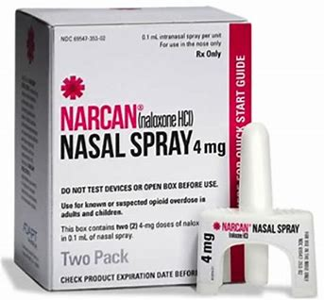
Naloxone (Narcan)
Following an opioid detox or a period of abstinence, a client is at higher risk for overdose as their tolerance has decreased:
Prescription medication that reverses an opioid overdose.
Can be obtained at pharmacies throughout CT without a doctor’s prescription and is covered by many insurance plans.
Should be on hand where individuals with an opioid use disorder may be.
Connections to ensure clients leave services with a kit in hand.
https://www.ct.gov/dmhas/cwp/view.asp?q=509650

Slide 58
Women’s REACH Navigators
REACH (Recovery, Engagement, Access, Coaching & Healing)
Women’s Navigators are women with lived experience who are living their own recovery and are willing to use their experiences to help others find their recovery path
Open to and knowledgeable about diverse pathways to recovery, community resources, and women’s health issues
Embrace the notion that one size does not fit all
Recovery Coaching & Case Management
Regionally based with a focus on community outreach & engagement
Experts at developing Family Care Plans
Referrals began in March 2019
Notes:
REACH- no wrong door to accessing services, they can call number on brochure and access REACH navigator in real time who will help connect them to resources and help them complete family care plan, reach and proud refer to each other- work in collaboration

Slide 59
REACH Enhancement
DMHAS has utilized SAMHSA funding to support the addition of a Family Recovery Navigator to each of the 5 REACH teams.
The Family Recovery Navigator uses their history of lived experience to assist the REACH team and expand the scope of services to support parenting caregivers impacted by substance use:
Partners of REACH clients
Single parent fathers, LGBTQ+ parents, and primary caregiving relatives
The Family Recovery Navigator provides holistic services though connection to treatment, recovery coaching, and case management.

Slide 60
WOMEN’S REACH REGIONAL PROVIDERS
15 Women’s Navigators statewide, 3 in each DMHAS region
Region 1- CASA
Region 2- The Connection
Region 3- ABH
Region 4- The Village for Children & Families
Region 5- McCall Center for Behavioral Health

Slide 61
Additional Key Resources
Access Line
Information on walk-in assessment centers throughout the state at www.ct.gov/dmhas/walkins or 1-800-563-4086
Screening & Warm hand off to detox services
https://www.sepict.org/
Safe Family Recovery
Safe FR
Offers three types of services to help meet the substance use treatment and recovery needs of adult caregivers connected to DCF wherever they are in their recovery
ACCESS Mental Health for Moms
https://www.accessmhct.com/moms/
Offers psychiatric expertise and consultation to medical providers treating perinatal birthing people with mental health or substance use concerns
SEPI-CT
Provides a host of resources for families and healthcare professionals on CAPTA and Family Care Plans
Screening for Substance Use in Pregnancy Training Series

Slide 62
Presenter Contact Information
Mary Fitzgerald (She/Her), LMSW
Family Care Plan Coordinator, Wheeler Clinic/CT Clearinghouse
Phone: 860-491-5311
Email: mkfitzgerald@wheelerclinic.org
SEPI-CT Website:
www.sepict.org
To learn more about DMHAS Women’s Specific Services including Reach and PROUD, contact:
Rebecca Petersen (She/Her), LCSW
Program Manager, Women’s Services, DMHAS
Phone: 860-490-5430
Email: Rebecca.Petersen@ct.gov
*DMHAS Women’s Services Website: https://portal.ct.gov/DMHAS/Programs-and-Services/Women/Womens-and-Childrens-Programs

Slide 63
For Individual Hospital Data Please Contact:
Lauren Kittle, MS
Program Supervisor
Office of Substance Use and Intimate Partner Violence
Department of Children and Families
Phone: 959.710.6295
Email: Lauren.Kittle@ct.gov

Slide 64
Evaluation
https://www.surveymonkey.com/r/CAPTAFCPtrainingeval

